Slide 1
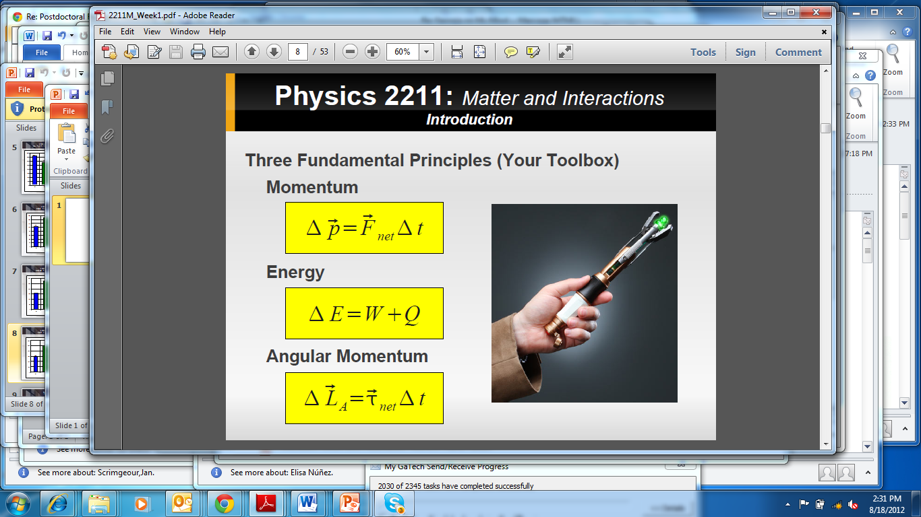
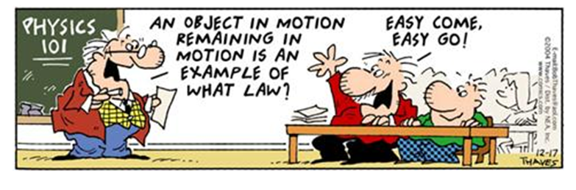
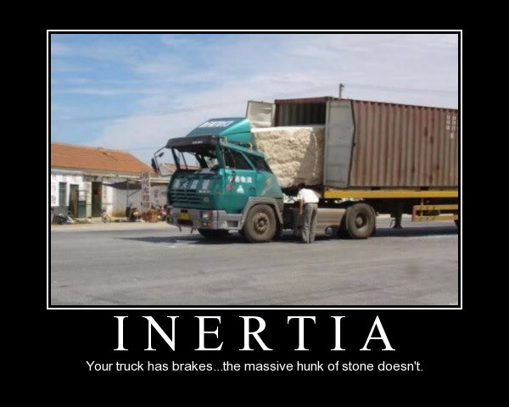
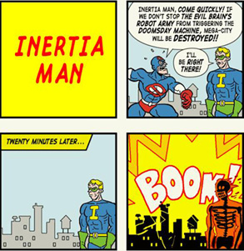
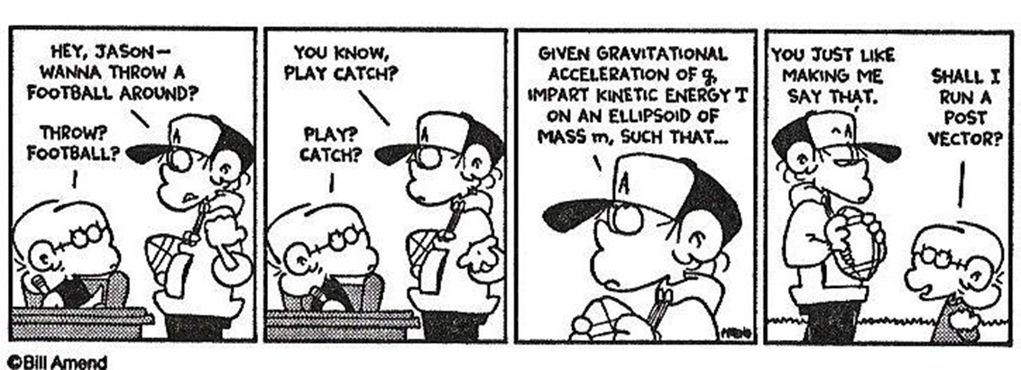
Class III ( interactions and momentum)
Todays objective:
Inertia and how to predict the dynamics of a system due to its surroundings and any external interactions.

Slide 2
Class II ( scalars and vectors)
First, quick review of Vectors.
Operations with vectors (new algebra):
Multiplication of a vector with a scalar.
Division of a vector with a scalar.
Addition of two vectors.
Subtraction of two vectors.
Calculating the magnitude of a vector
Calculating the rate of change of a vector
Multiplications of vectors (two types, dot and cross product). These two will be study later in the semester.

Slide 3
Class II ( scalars and vectors)
Operations NOT possible with vectors:
Vector equal to a scalar.
Vector can not be added/subtracted to a scalar.
Division by a vector (but you can divide by the magnitude of a vector).

Slide 4
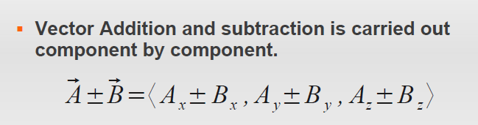
Class II ( scalars and vectors)
Operations with vectors (new algebra):
Addition/subtraction of vectors analytically
a-b
b
a+b
b
a
a

Slide 5
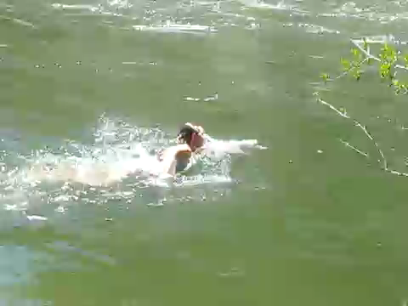
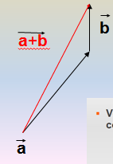
Class II ( scalars and vectors)
Fun with vectors (Example of Adding)

Slide 6
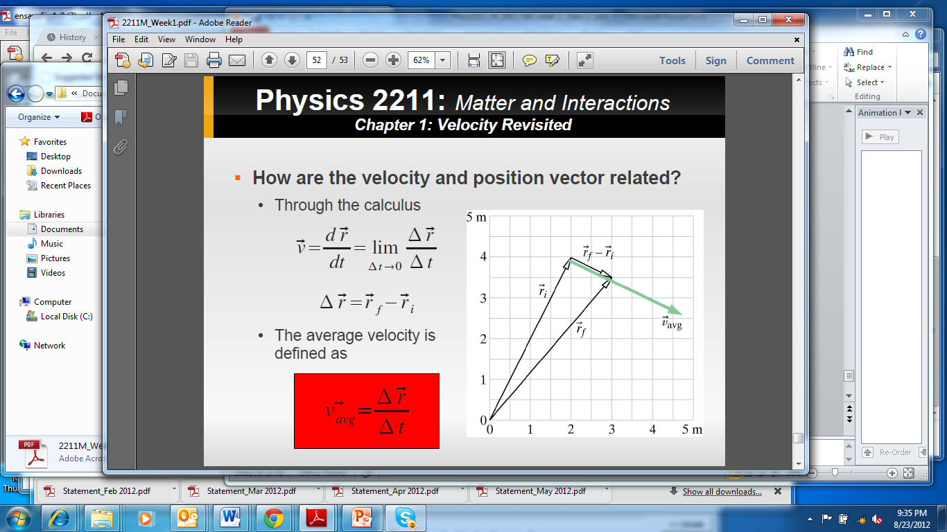
Class II ( scalars and vectors)
Fun with vectors (Example of subtracting)
Velocity as a change in position (from a vector point of view)
V_{avg} = r_{f} – r_{i}
t_{f} – t_{i}
V_{avg} = <x_{f},y_{f},z_{f}> - <x_{i},y_{i},z_{i}>
t_{f} – t_{i}

Slide 7
Class II ( scalars and vectors)
The problem with averages!
Average Velocity Vs. Instantaneous Velocity
Trajectory 1 took 3 seconds
Trajectory 2 took 3 seconds
Same V_{avg}
Y
r_{f}
r_{i}
X

Slide 8
Class II ( scalars and vectors)
The problem with averages!

Slide 9
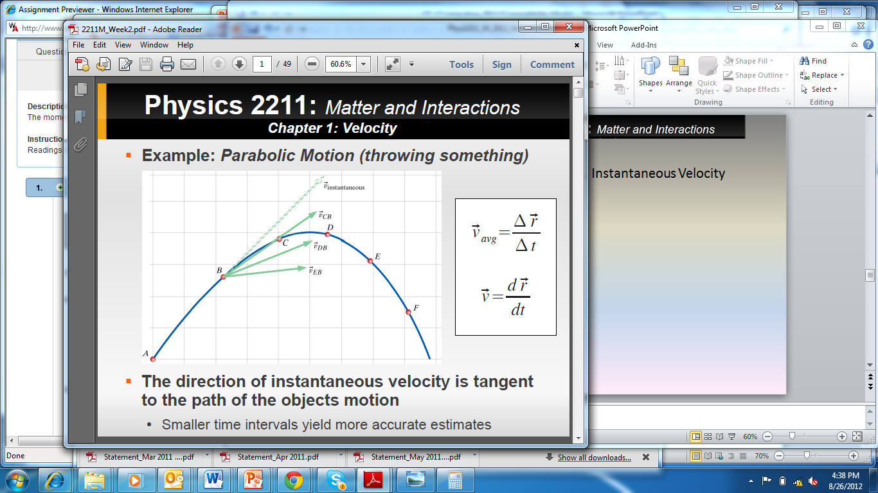
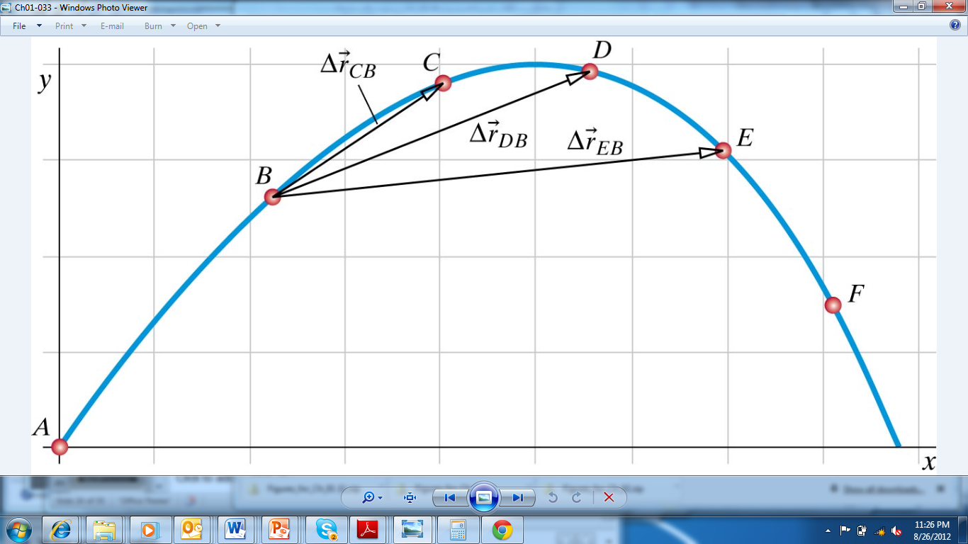
Average Velocity Vs. Instantaneous Velocity

Slide 10
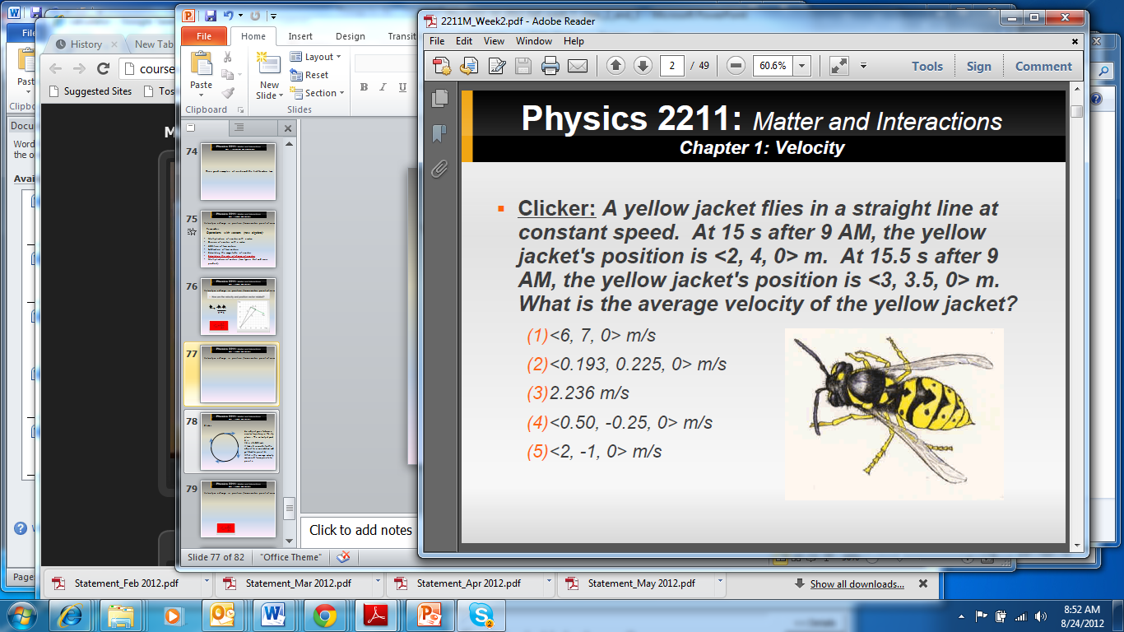
Class II ( scalars and vectors)
Velocity as a change in position (from a vector point of view)

Slide 11

Class II ( scalars and vectors)
Velocity as a change in position (from a vector point of view)
< 3-2 , 3.5-4 , 0 > /(15.5-15) (m/s) = < 2, -1, 0 > m/s

Slide 12
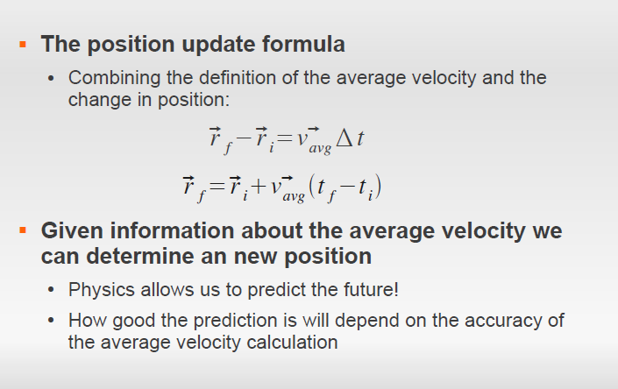

Slide 13
Class II ( scalars and vectors)
Predicting a new position.
Clicker: 12.18 s after 1:30 pm a yellow jacket’s position is
<20, 8, -12> m, and velocity is <9,-4,6> m/s.
If we assume that the velocity of fly is constant
Where will it be (vector position) at 12.21s after 1:30 pm?
24.75m
<20.27, 7.88, -11.82> m
<0.27, -0.12, 0.18>m
<129.62, -40.72, 61.08>m
<129.89,-40.84, 61.26>m

Slide 14
Class II ( scalars and vectors)
Predicting a new position.
Clicker: 12.18 s after 1:30 pm a yellow jacket’s position is
<20, 8, -12> m, and velocity is <9,-4,6> m/s.
If we assume that the velocity of fly is constant
Where will it be (vector position) at 12.21s after 1:30 pm?
24.75m
<20.27, 7.88, -11.82> m
<0.27, -0.12, 0.18>m
<129.62, -40.72, 61.08>m
<129.89,-40.84, 61.26>m
< 20 , 8 , -12 > m + < 9 , -4 , 6 > m/s (0.21- 0.18) s
< 20 , 8 , -12 > m + < 0.27, -0.12, 0.18 > m = < 20.27 , 7.88 , -11.82 > m

Slide 15
Class II ( scalars and vectors)
Predicting a new position.
Clicker: 12.18 s after 1:30 pm a yellow jacket’s position is
<20, 8, -12> m, and velocity is <9,-4,6> m/s.
If we assume that the velocity of fly is constant
Where will it be (vector position) at 12.21s after 1:30 pm?
What would be its Speed?
133m/s
11.532 m
1.1532 m/s
<20.27, 7.88, -11.82> m/s
24.75 m/s

Slide 16
Class II ( scalars and vectors)
Predicting a new position.
Clicker: 12.18 s after 1:30 pm a yellow jacket’s position is
<20, 8, -12> m, and velocity is <9,-4,6> m/s.
If we assume that the velocity of fly is constant
Where will it be (vector position) at 12.21s after 1:30 pm?
What would be its Speed?
133m/s
11.532 m
1.1532 m/s
<20.27, 7.88, -11.82> m/s
24.75 m/s
Sqrt (20.27 ² + 7.88 ² + 11.82 ² ) = 24.75

Slide 17
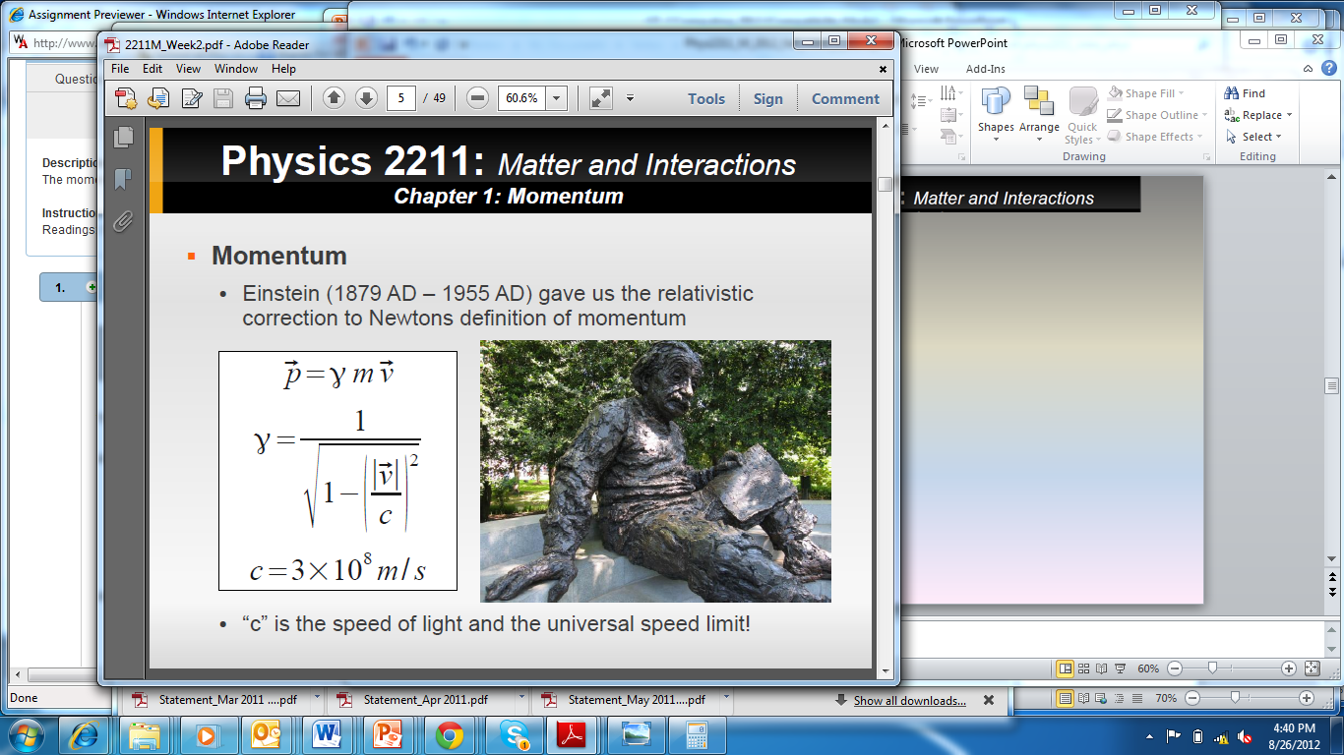
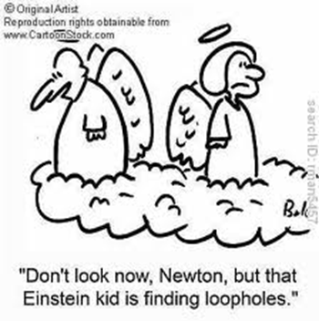

Slide 18
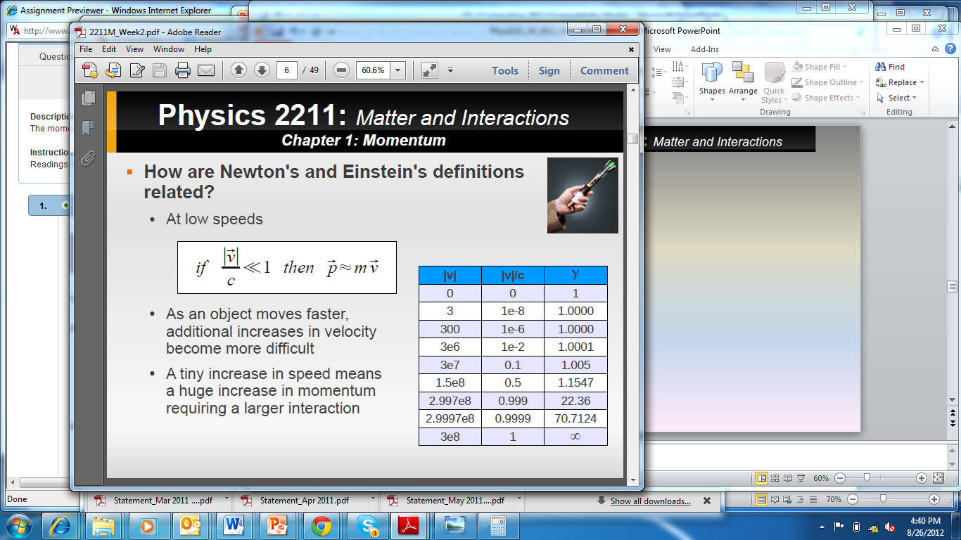

Slide 19
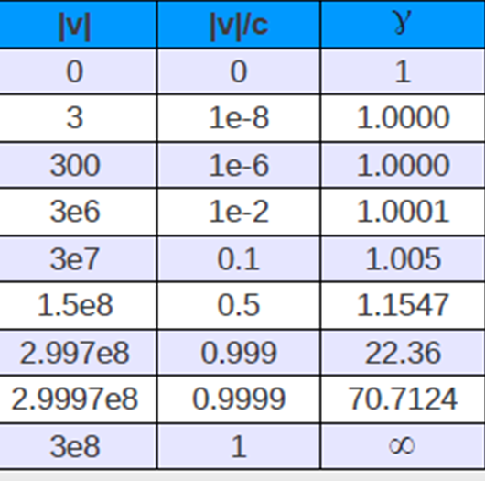
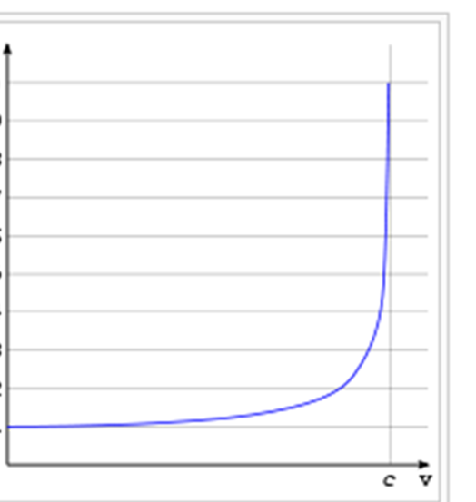
Velocities:
Usain Bolt 10.36 m/s
Cheetah and Sailfish 31 m/s
The Bugatti Veyron 120 m/s
Bullets 350 m/s
X-15 aircraft 2,020 m/s
Apollo-11 11,000m/s
Solar system
around milky way 200,000 m/s
Electron (cathode ray) 3x10 ⁷ m/s

Slide 21
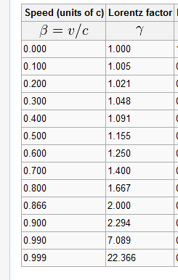
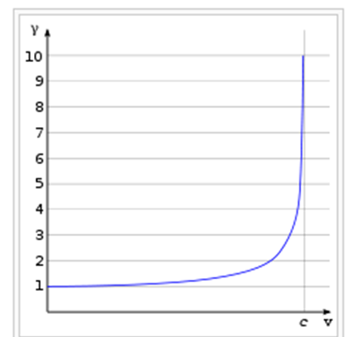
Lorentz factor
Gama graph
Clicker:

Slide 22
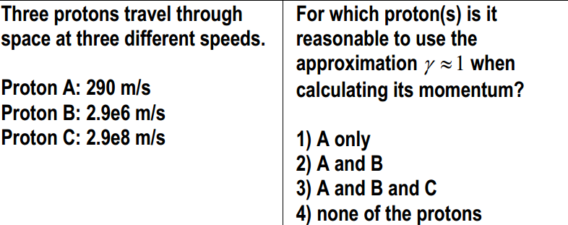
Gama figure
Gama graph
Clicker:

Slide 23
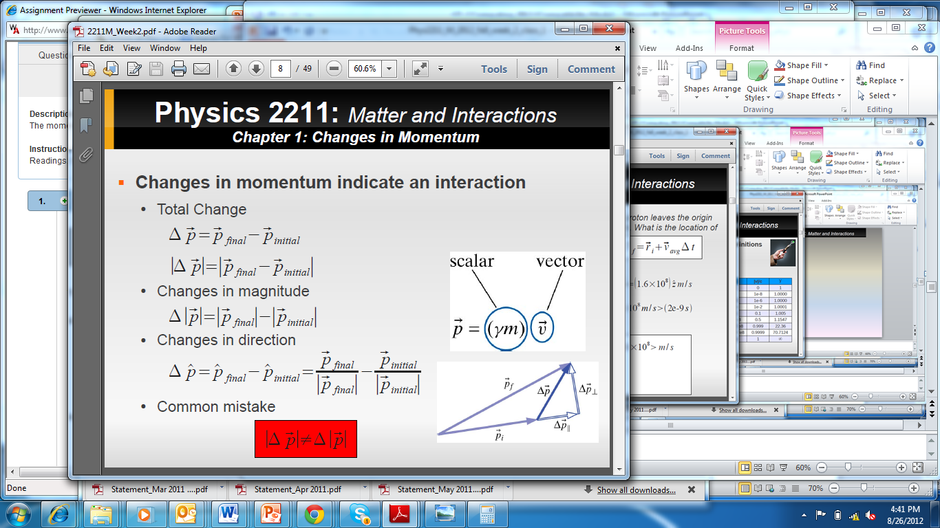
Very important!!!

Slide 24
Class II ( scalars and vectors)
Summary questions:
How many numbers needed to specify a 3D vector?
How many numbers needed to specify a scalar?
Does it makes sense to say that a vector can be positive or negative?
Answer: No
example <10, 0, -.5>

Slide 25
Class II ( scalars and vectors)
Summary questions:
Can the magnitude of a vector be negative?
Answer: No, it is always positive.
Are all the components of a unit vector always less than one?
Is vector addition commutative?
Answer: yes
Is vector subtraction commutative?
Answer: No
Answer: yes.

Slide 26
Class II ( scalars and vectors)
Velocity as a change in position (from a vector point of view)
Remember:
Operations with vectors (new algebra):
Multiplication of a vector with a scalar.
Division of a vector with a scalar.
Addition of two vectors.
Subtraction of two vectors.
Calculating the magnitude of a vector
Calculating the rate of change of a vector
Multiplications of vectors (two types, dot and cross product).

